Slide 1
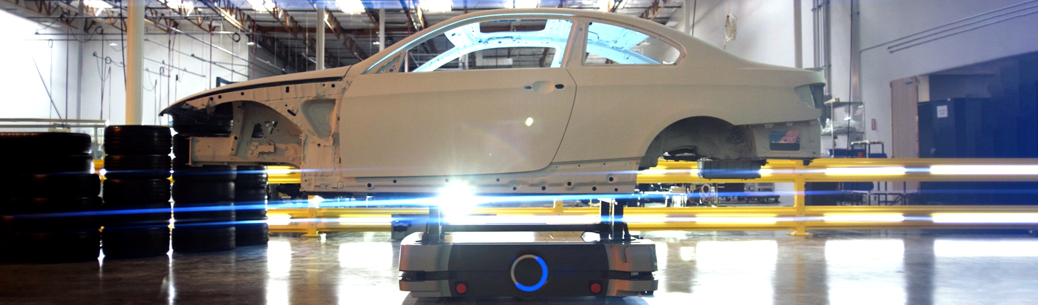
Building the Automotive Factory of the Future
September 2021
Notes:
Hi everyone my name is Whitney Lojewski, and I’m the Automotive Industry Marketing Manager at Omron. We’re very excited to present to you along with our system integrator partner Valiant TMS.

Slide 2
Agenda
Omron introduction
Whitney Lojewski, Industry Marketing Manager – Automotive, Omron
Industry 4.0 vision and steps to get there
Jean-Marie Evrard, Global Director R&D, Business Development Aerospace & Strategic Accounts, Valiant TMS
Traceability for the factory of the future
Eric Henefield, Director – Traceability Business, Omron
Q&A
Steve Bell , Jean-Marie Evrard, Eric Henefield & Rick Tomaszewski, Strategic Account Manager – Automotive, Omron
Notes:
Here is a more detailed look at our agenda. I will share a video about Omron then Jean-Marie Evrard will introduce Valiant TMS and how they serve customers throughout the entire automotive production process. He will also explain the Industry 4.0 Technology Pillars and show specific use cases to explain the steps to get there. As a system integrator partner of Omron’s, Valiant TMS does a great job of providing a full view of Industry 4.0 for the automotive industry. Then Eric Henefield will talk specific about the roll of traceability 4.0 in building the factory of the future. Our colleague Rick Tomaszewski will join everyone at the end for Q&A. Now here is a video about Omron.

Slide 3
Video
Omron brand video

Slide 4



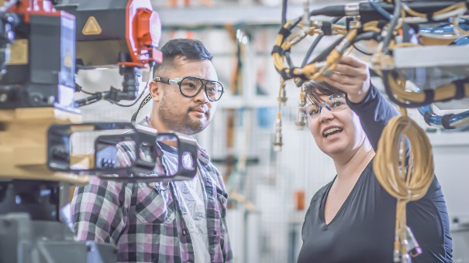

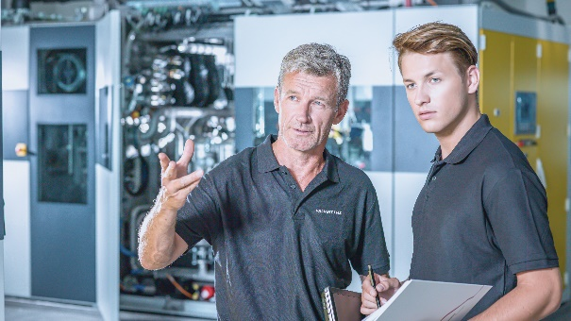
About Valiant TMS
We design, build and integrate intelligent automation solutions that leverage new technologies to create smart and sustainable factories for the world’s leading companies.
Highlights
Highly-skilled and diverse team of professionals
Culture driven by integrity, quality, and customer satisfaction
Commitment to sustainability and community partnership
A leader in digital transformation and Industry 4.0 integration
Extensive portfolio of successful projects
Global systems, processes, resources, and capacity
Full-service supplier – a single source for complete solutions
Notes:
Valiant TMS is a full-service Industry 4.0 system integrator with teams strategically positioned around the world, leading the way in digitalization, process development, design and technology integration.

Slide 5
Video
01-valianttms-company-overview.mp4

Slide 6
Global Locations and Resources
Linz, Austria
2 Locations
Sarleinsbach, Austria
Cologne, Germany
Augsburg, Germany
Olomouc, Czech Republic
Gliwice, Poland
Oradea Romania
Kaluga, Russia
Barcelona, Spain
Sa
E
M
Se
P
Q
E
Sa
E
Sa
E
M
Se
P
Q
Windsor, Ontario, Canada
6 Locations
Sa
E
Sa
E
M
Se
P
Q
Sa
E
M
Se
P
Q
Auburn Hills, Michigan, USA
Sa
E
Sa
E
M
Se
P
Q
Sa
E
M
Se
P
Querétaro, Mexico
M
Se
Sa
E
Sa
Se
São Paulo, Brazil
Pune, India
Sa
E
M
Se
P
Q
Pretoria, South Africa
Sa
E
Legend
Sa
Sales
E
Engineering
M
Manufacturing
Se
Service
1,250+
Team Members
20
Locations
13
Countries
1.3 Million
Square Feet Capacity
62
Years in Business
P
Procurement
Q
Quality
Notes:
Our global footprint enables us to serve our customers wherever they operate.

Slide 7



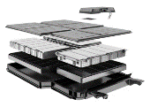





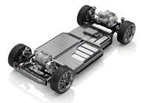
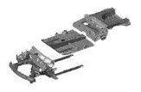
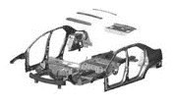
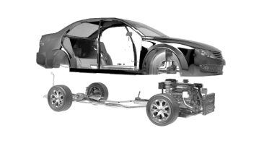
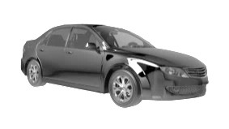


Automotive Value Chain
Casting Automation
Scope of supply to the automotive production process
Machining Automation
and Washers
Complete Body Shop Assembly Automation
Electric Motor and Battery Assembly and Test
Integrated Material Handling Systems (Robotic Integration / Floor & Overhead Conveyors)
Powertrain System
Sub-Assembly
and Test
Forming Dies
(with Partner)
Propulsion System
Final Assembly
Structural Reinforcement
Sub-Assemblies
Roof Panel
Sub-Assembly
Vertical
Integration
Closure
Sub-Assembly
Chassis
Sub-Assembly
Battery Tray
Sub-Assembly
Bodyside Panel
Sub-Assembly
Hemming
Chassis
Assembly
Underbody
Sub-Assembly
Underbody
Marriage
Framing
Closure
Hang
Body Chassis Marriage
Final Assembly
(Component Installation)

Slide 8
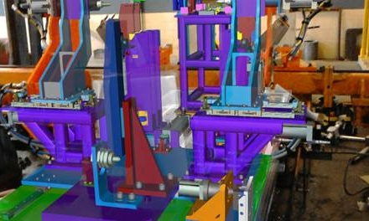
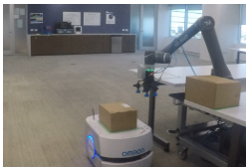
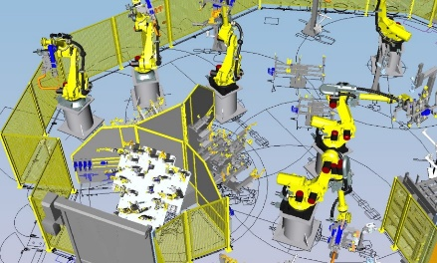
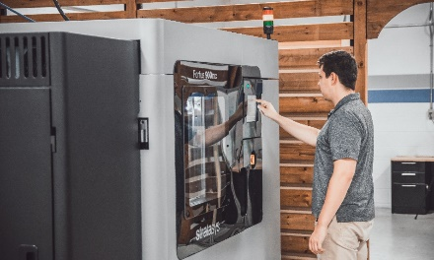

Industry 4.0 Technology Pillars
Big Data, AI, ML, DL
Simulation
Autonomous Robots
and Guidance
Augmented, Virtual and Mixed Reality
System Integration
Industry 4.0
Additive Manufacturing
Internet of Things
Cloud Computing
Cybersecurity

Slide 9
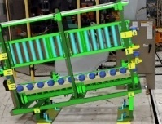
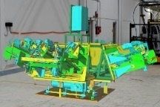
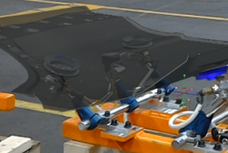
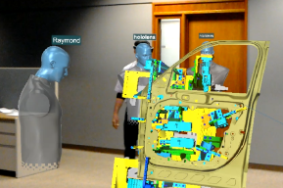
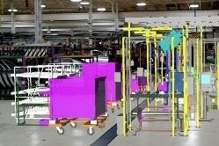
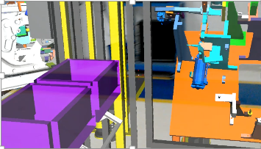
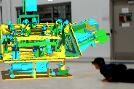
Augmented Reality Use Cases (Microsoft HoloLens)
User Acceptance
Tool Build Review
Kit Build Review
Virtual Metal Overlay for Buy-off
Multi-User Reviews (Global)
Line Build Review
Ergo Review and Operator Training
Upfront Maintainability Review
Under development

Slide 10
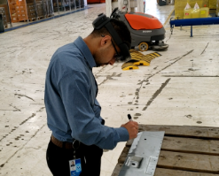
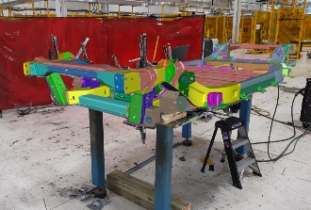
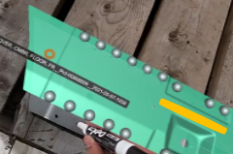
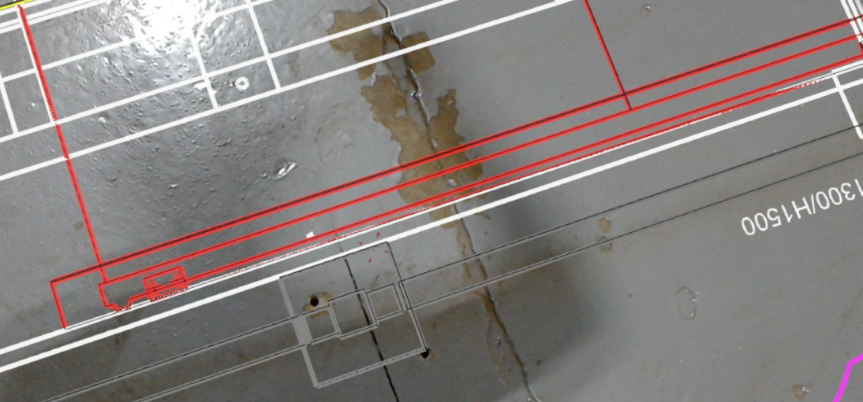
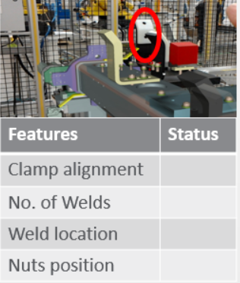
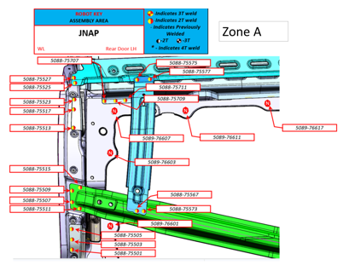
Augmented Reality Use Cases (Microsoft HoloLens)
User Acceptance
Under development
Floor Layout Verification
Direct Weld Marking on Panels
Fixture Free Rapid Prototype Build
Mastic/Sealer Panel Layout
Floor Layout Drawing
Inspection Checklist Tool
Holographic Audit Tool

Slide 11
Video
02-valianttms-augmented-reality-ergonomics-review.mp4

Slide 12
Video
03-valianttms-augmented-reality-remote-design-review.mp4

Slide 13
Video
04-valianttms-augmented-reality-virtual-line-walk.mp4

Slide 14
Video
05-valianttms-augmented-reality-floor-layout-verification.mp4

Slide 15
Video
06-valianttms-augmented-reality-qr-code.mp4

Slide 16
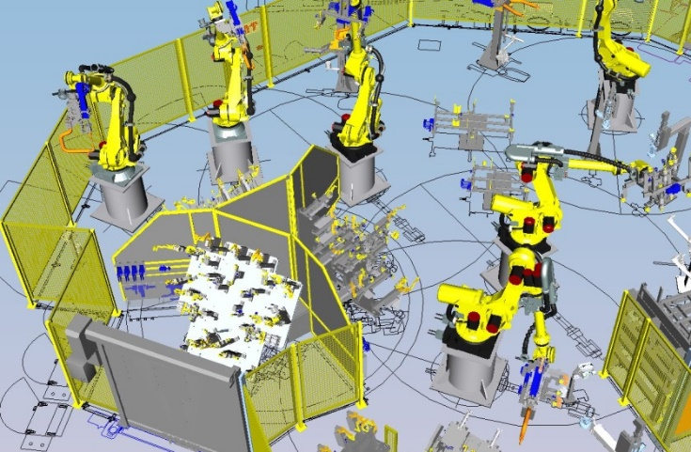
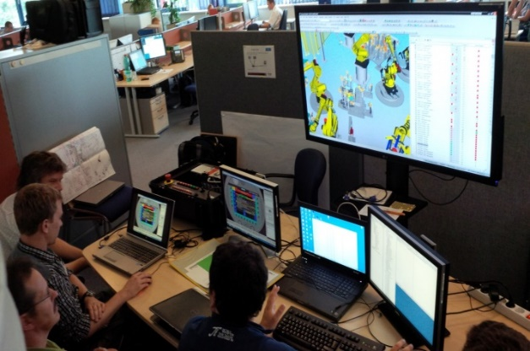
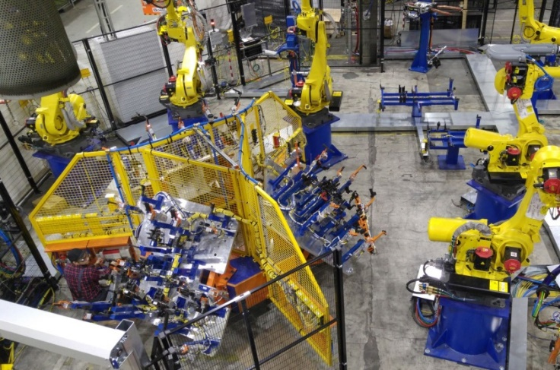
Simulation and Virtual Commissioning
PLC and Robot Offline Programming
Mechanical Engineering
Handover to Electrical Engineering
Electrical Engineering

Slide 17
Video
07-valianttms-innovation-center.mp4

Slide 18
Video
08-omron-amr-study.mp4

Slide 19
Video
09-valianttms-factory-of-the-future-v5.0.mp4

Slide 20

Traceability for the factory of the future
Eric Henefield, Director – Traceability Business, Omron

Slide 21
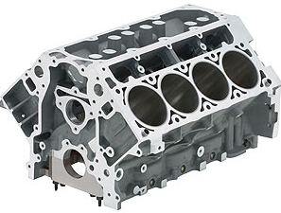
Track, Trace and Control
Track
Data to determine in real-time “Where is it now?”
Trace
Data to answer
“Where has it been?”
Control
Data to decide next steps
“Where should it go?”
[Enhanced Productivity Through Data]
Notes:
Thanks to Valiant for the overview of the FOF. I will now pivot into a more detailed view of traceability and how serialization plays a major part in overall digital transformation.

Slide 22
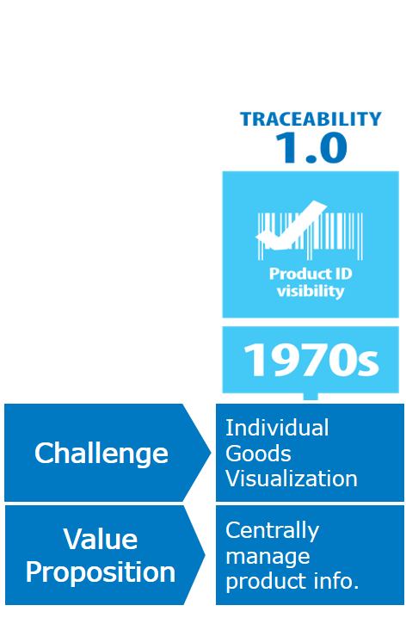
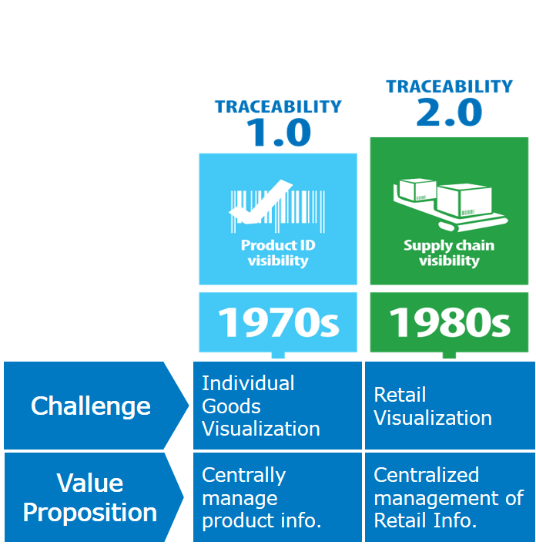
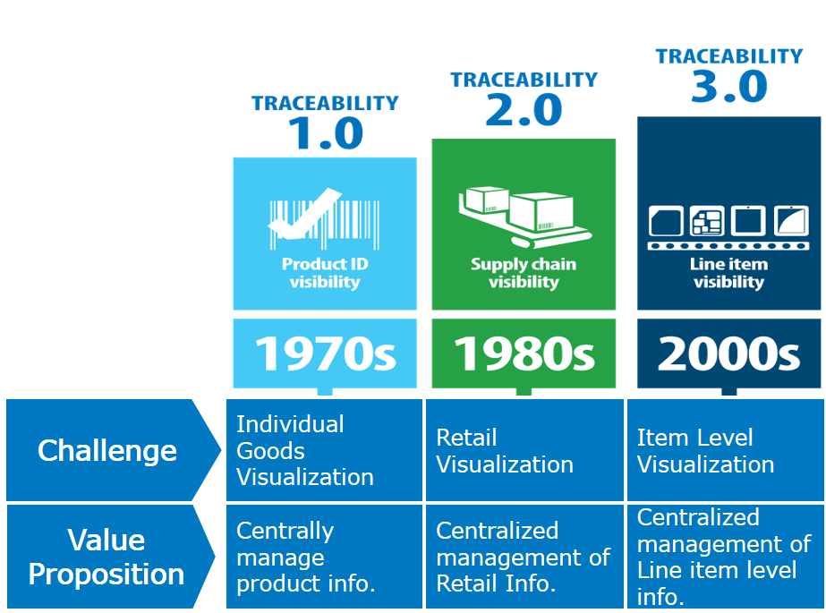
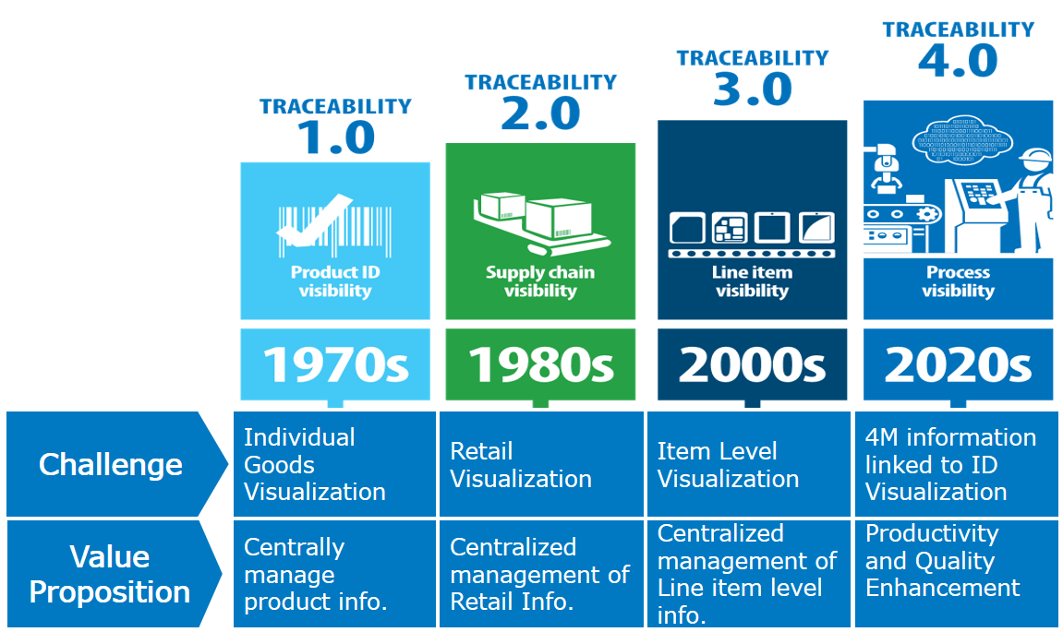
Traceability Evolution/Traceability 4.0 Concept

Slide 23
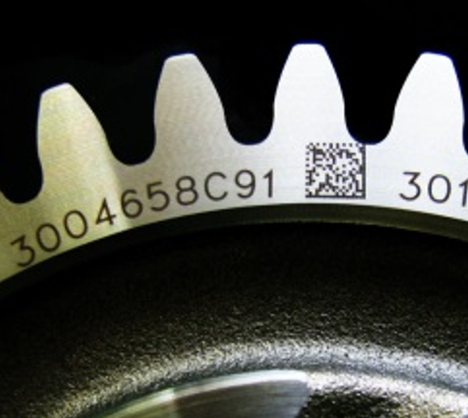
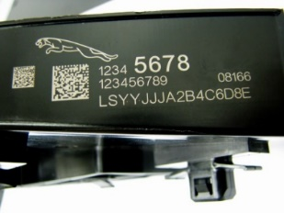
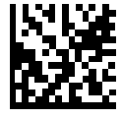
Traceability 3.0/4.0: Unit-Level Traceability
Extends serialized identification to individual parts
Covers a traceability “hole” on the production floor
Enabled by 2D Data Matrix codes directly marked on parts (DPM)
Unit Level
Traceability
Vendors
Receiving Inspection
Manufacturing
Testing
Packaging
Shipping
Barcode (License Tag)
Directly Marked 2D Codes
Barcode (License Tag)
Database

Slide 24

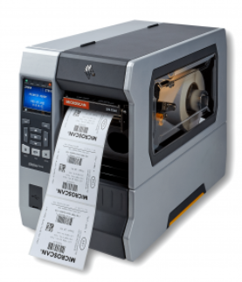
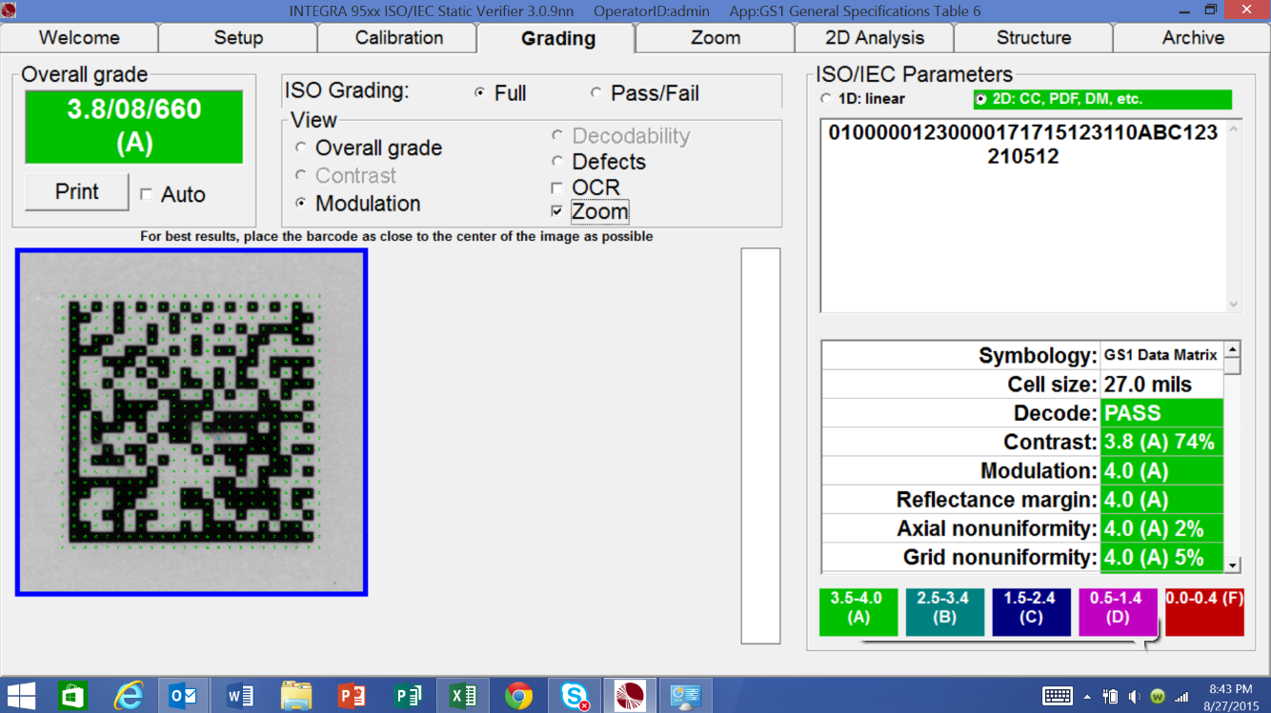
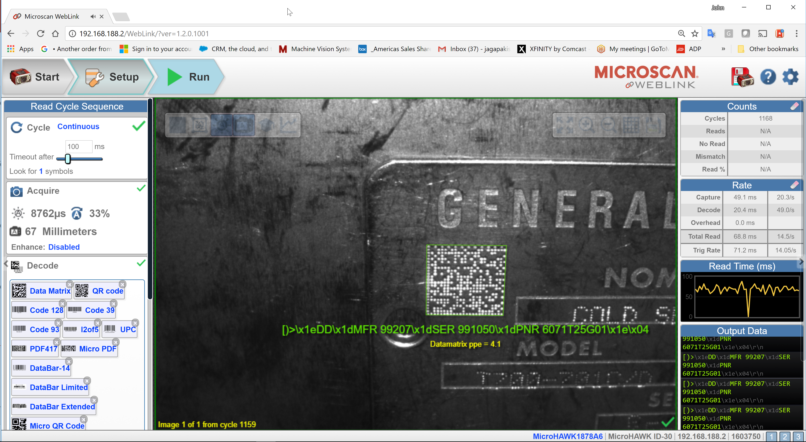
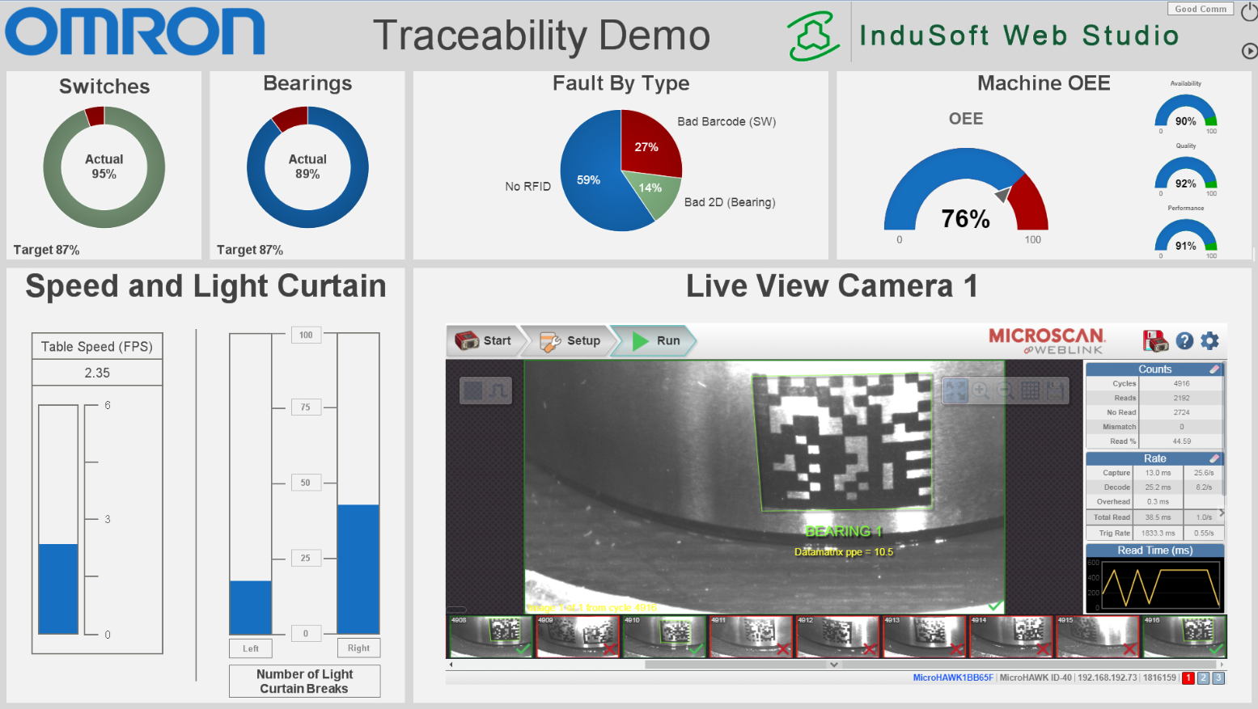

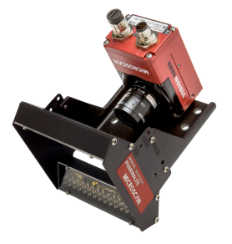
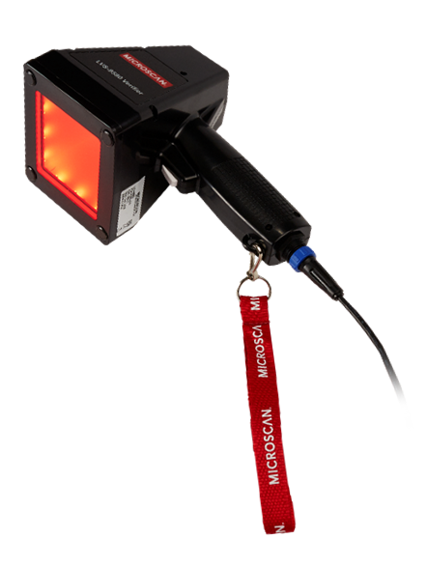
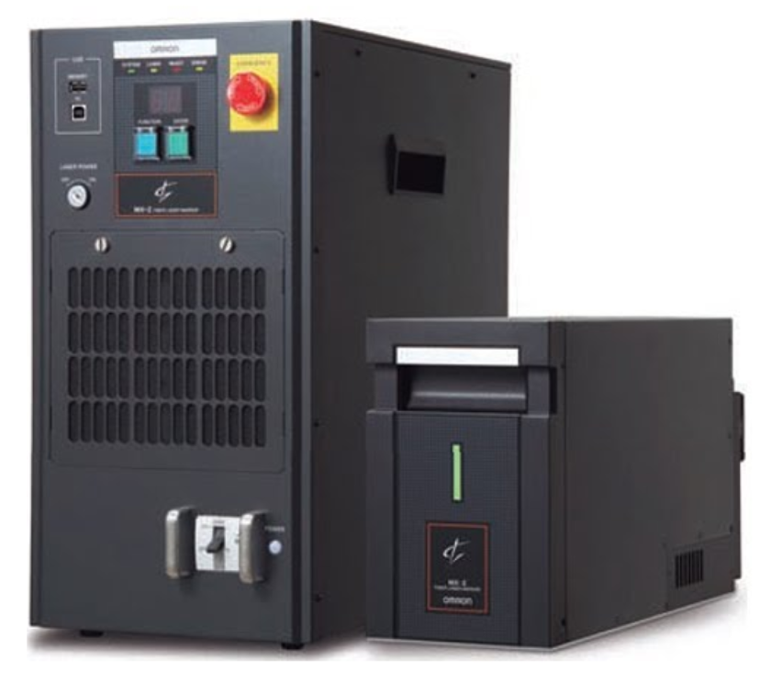
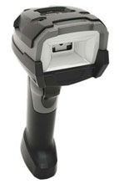
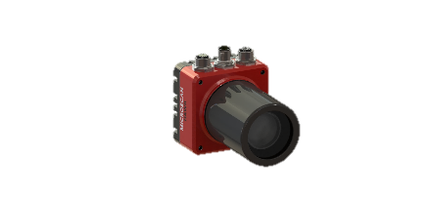
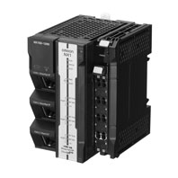
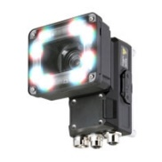

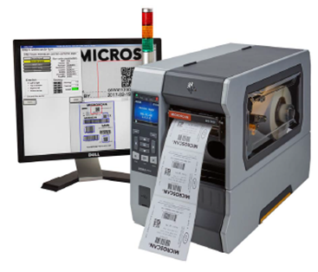
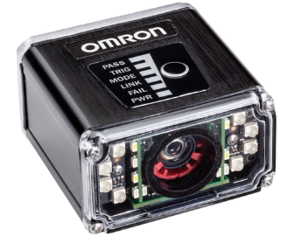



The OMRON MVRC Traceability Deployment Methodology
M
V
R
C
MARK
VERIFY
READ
COMMUNICATE
Select the right
marking/printing process and process
parameters
for the application
Communicate
data to the PLC and beyond
Use off-line and/or
in-line verifiers to
check/monitor
mark/print quality
Select proper
reader
configurations
for the application
Notes:
Omron Controller products are capable to communicate these data protocols today (with no middle-ware). Our PLC products can double as IoT gateway devices, or be used as separate EDGE devices (so as to not interfere with your existing manufacturing architecture.

Slide 25






Typical Traceability Software Tasks
Connect to and communicate with:
Markers, printers, barcode readers, vision systems, Sensors, Safety Scanners, PLCs, robots, processing equipment, data bases, ERP systems…
Follow a part along all relevant process steps
Record part ID when part is marked
Record marking process data
Confirm and record mark quality data during in-line DPM verification
If mark quality is acceptable, allow part to move to next process steps
Error-proof each process step
Check that no processing steps have been skipped
Record time when each part enters each processing cell on each processing line
Record relevant processing data for each process step
Gather manufacturing process data (temperature, position, vibration, speed) for predictive maintenance…
Communicate throughout the manufacturing ecosystem
Notes:
Each of the products contributing to the MVRC methodology cannot be an island of information. Laser markers, printers, barcode readers, RFID reader/writers, verifiers, vision systems, PLCs, robots, and more must be able to share important information with other parts of the production system. This begins with the process of communicating from an MES or ERP system information that is to be embedded in mark to the software used to generate the barcode or write to an RFID tag. This is the first step in the genealogy of the mark, and subsequently may be read and communicated multiple times throughout the life of that barcode. The barcode reader or RFID controller would commonly communicate the contents of the barcode or tag to a PLC via serial or industrial Ethernet based protocol. Information in the barcode string such as product ID may guide other equipment in the manufacturing process to act upon the product carrying the barcode. Pairing of components, process steps, and packaging materials may all be driven by the information coming from the barcode. Further, process data such as test results in the case of an RFID tag may be written to the tag that stays with the product throughout the production process, and eventually tied in a production history database to the serial # of the final assembly. Further logic can be applied to prevent a production step from occurring prior to a necessary prior step being completed, by reading the barcode or RFID unique identifier for a given part and inspecting its production history prior to performing the next step in the process. To measure takt times the time stamp associated with a barcode or RFID read can be communicated and stored in a production database allowing for OEE, overall equipment effectiveness analysis. Finally even images of defective parts can be communicated and stored in a quality database for review and further action.

Slide 26



Mark Verify Read Communicate
Traceability 4.0
Analytics
Visualization
Communicated Data = Value
  Quality assurance
  Part verification (anti-counterfeit)
  Connected Supply Chain
  Scrap reduction
  Productivity improvements
  Demand forecasting (inventory mgmt.)
  Predictive maintenance
  Prescriptive analytics
  Regulatory Compliance
Control what happens!
What will happen?
Why did it happen?
What happened?
Leverage data to make real-time decisions

Slide 27











Supporting Your Traceability Implementation Journey
Motivation is “WANT TO”
Motivation is “NEED TO”
Data Utilization on-site
Productivity
Quality
Motivation is “HAVE TO”
Perfecting Implementation
System Installation
Expand variation
Regulation
(AIAG, IATF, …)
Customer request
Traceability 4.0
Phase2
Using Traceability system
No Traceability system
Phase1
Implementing Robust Traceability through MVRC
Expanding Solution with Process Data
Notes:
In conclusion, we here at Omron are ready to support you no matter where you are in your traceability implementation journey. This could range from incrementally adding traceability functionality within your existing production system, to providing a more holistic solution including multiple pieces of the MVRC toolkit which we have discussed. Thank you for your time today and we will now open up the line for questions.

Slide 28
Video
Omron Traceability 4.0 demo

Slide 29

Omron Proof of Concept Centers
PoC Locations: Amherst, Chicago, Cincinnati, Dallas, Detroit, Leon, Los Angeles, Sao Paulo, Toronto
Notes:
If you would like to see some of these T4.0 technologies in action, please feel free to visit our PoC center in Novi, MI for more information. In Novi we have a multi-station simulation showing how product and data is moved between stations of a manufacturing facility. Using robots, sensors, code readers, safety, and Communication gateways, we can walk you through every step of the process and answer any questions you might have regarding traceability implementations. Let Omron help you begin to visualize your organization’s traceability solutions – regardless of where you are in your journey, we can help!

Slide 30


thank
you
automation.omron.com

