Slide 1

Factory Drive Recorder Technical Training
July, 2022

Slide 2
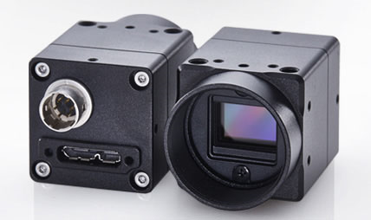
Introduction
What does Factory Drive Recorder do?
  Captures videos up to 5 min. before a trigger and up to 5 min. after the trigger
  Live monitoring
How it does it work?
  Stores raw video in a loop.
  When a trigger is received, it saves the raw video as a compressed file.
What is it good for?
  Diagnostics for intermittent faults.
    Unauthorized access
    Mechanical problems on factory line
    High speed captures of errors
  Remote Monitoring
  Manual Viewing

Slide 3
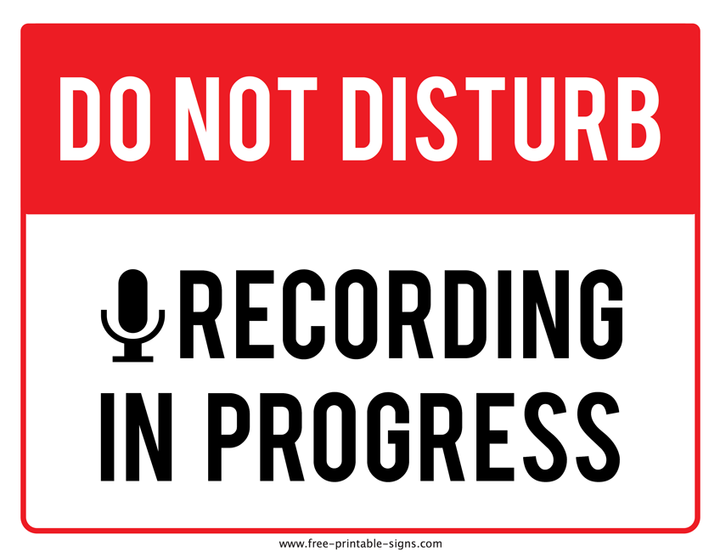
Features
6 recording modes
  Motion Trigger
  Master Image Correlation Trigger
  Timed Trigger
  External Trigger
  Manual recording
  Continuous Recording
    Up to 1 year
      limited by available computer storage
Up to 8 cameras
  GigE Vision, M-Series
  USB3 Vision, M-Series
  Board mount, B-Series
  UVC (Does not mix with other cameras)
  USB3 Vision Remote Head

Slide 4
Types of triggers
Motion trigger
  Looks for a change in the image
  Must select an area to look for changes
  Settings are available to determine how much of a change is required
Master Image comparison
  Looks for a difference from the master image
  Must select an area to look for changes
  Settings are available to determine how much of a change is required
Timed Trigger
  Will trigger one time per day
  You select the time of day for the trigger
External Trigger
  Software Trigger
    Capture starts based on an Ethernet command to the IPC with Factory Drive Recorder running
  Hardware trigger
    Capture starts based on an input change to Line 1 in on a specified camera

Slide 5
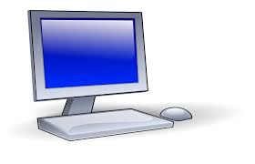
limitations
Performance is limited by the computer’s performance
  Computer’s speed is affected by:
    Type of processor
    Type and size of memory
    Type of hard drive
    Any additional apps that are running on the computer
    Any additional bandwidth on the network/USB
  Available recording time is limited by:
    Hard drive space
    Cameras
      Number
      Resolution
      Frame rate

Slide 6
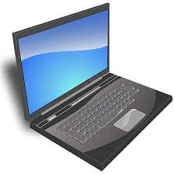
Recommended Computer specifications
Processor
  Intel i7, 3GHz+
Memory
  16GB, high speed
Hard Drive
  Solid State
  Size based on storage time and cameras
Operating System
  Windows 10
Recommended Omron IPC
  NYB27414M2
  NYB27414P2

Slide 7
Typical Speed limitations
Pixels (MP) | # of Cameras | Interface | Frame Rate (FPS)
0.4 | 1 color | USB3.0 | 330
0.4 | 1 momo | USB3.0 | 44
0.4 | 2 color/mono | USB3.0 | 300
0.4 | 8 color | GigE | 30
1.3 | 1 color | USB3.0 | 60
1.3 | 1 mono | USB3.0 | 60
1.3 | 2 color/mono | USB3.0 | 60
1.3 | 4 mono | USB3.0 | 30
1.3 | 1 mono | GigE | 45
2.0 | 2 mono | GigE | 25
2.0 | 4 color/mono | GigE | 10
3.0 | 1 mono | USB3.0 | 55
3.0 | 2 mono | USB3.0 | 55
5.0 | 1 color | USB3.0 | 35

Slide 8

Normal sequence
Install Software
Install cameras
Start Factory Drive Recorder
Configure cameras
Configure image capture
Wait for event

Slide 9
Installation
Install SentechSDK
Install Factory Drive Recorder
Connect Cameras

Slide 10
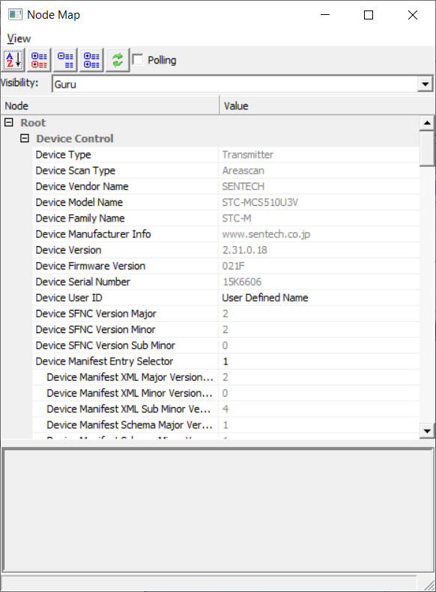
Configuring cameras
Have cameras powered and connected before starting the Factory Drive Recorder
Register each camera
Adjust camera settings for each camera
  Use the StViewer button for more settings
  Auto Exposure is recommended for most cases
  Click “OK” to exit settings
    do not use the X at the top right

Slide 11
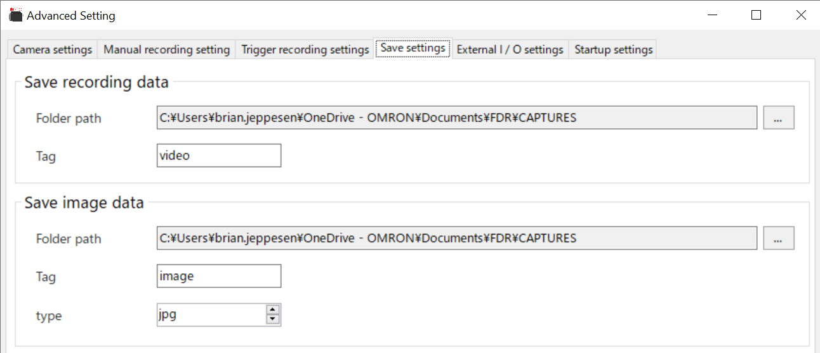
Setup recording location
Select settings/Save settings
  Specify the folder paths for videos and images

Slide 12
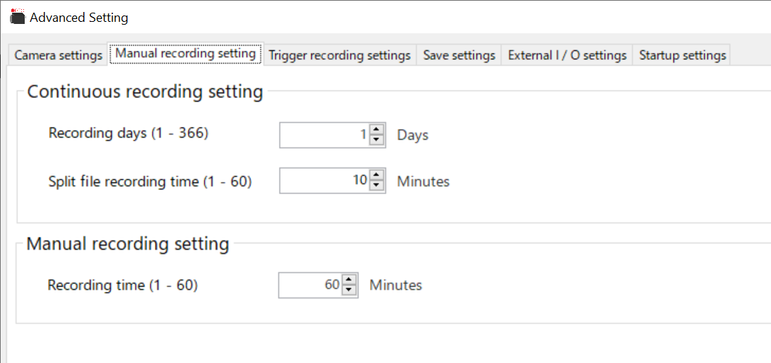
Manual recording
Select Settings/Manual recording setting
Enter the maximum recording time
Click “OK”
Change box in top center to Manual recording
Press REC
Status will be “Recording”
Press REC to stop

Slide 13
Continuous recording
Select Settings/Manual recording setting
Enter the recording time
  In days
Enter the file size
Click “OK”
Click on the box on the top right
  Change from REC off to Cont. REC
Status does not update
Press REC to stop

Slide 14
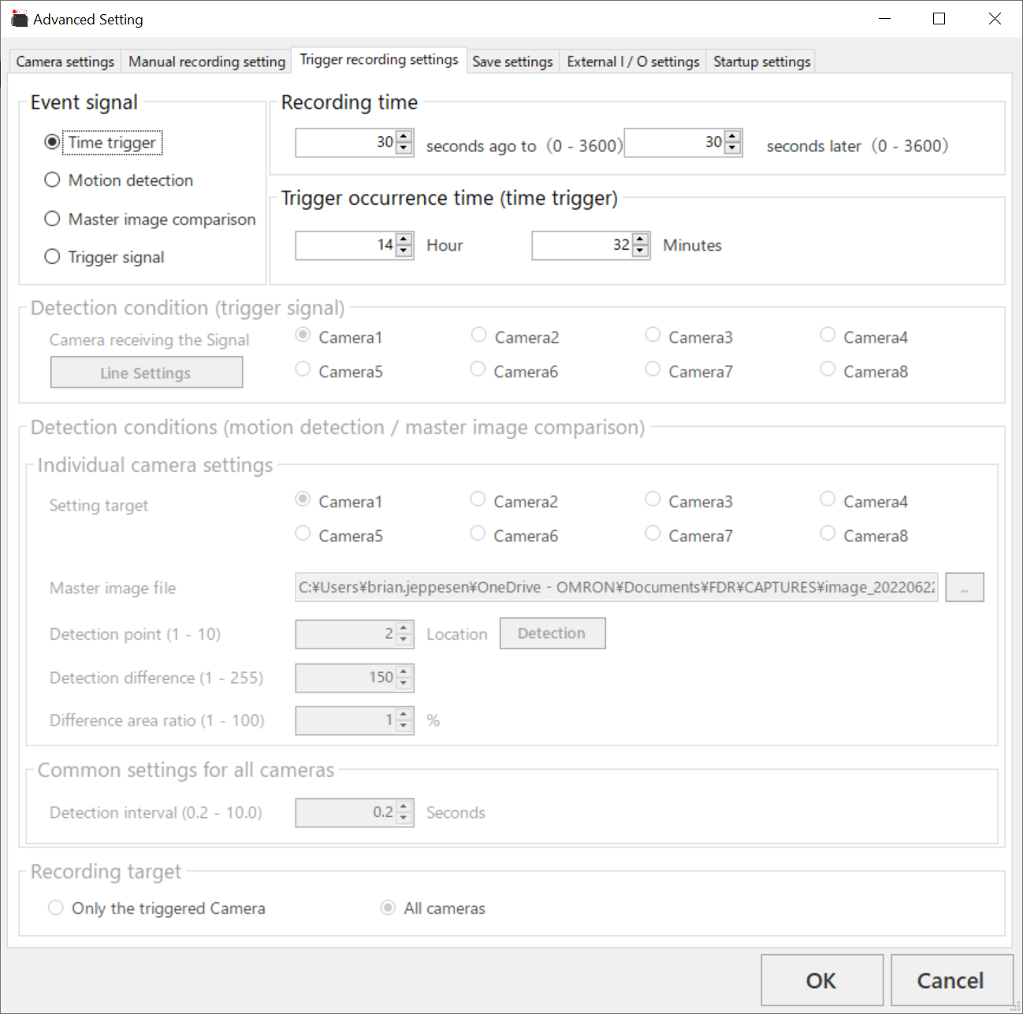
Setup for Time trigger
Select settings/Trigger recording Settings
Select Event Signal to Time Trigger
Specify how long to record, before and after the Trigger.
Specify the time of day
  24hr clock
    13 = 1:00PM
Click “OK”
In main page Change from manual recording to trigger recording
Click the REC button
  Will see Waiting for Trigger
It will record at the specified time each day

Slide 15
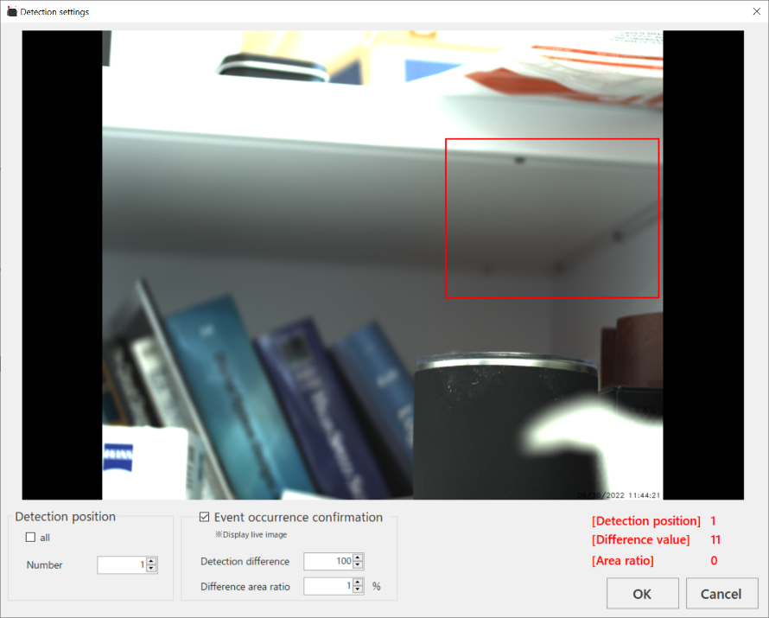
Setup for Motion Detection
Select settings/Trigger recording Settings
Select Event Signal to Motion detection
Specify how long to record, before and after the Trigger.
Specify Camera(s) to monitor
Use Detection point to select how many monitoring areas will be used
Press Detection to set up each area
  Detection Difference
    The amount of change from previous frame to cause a trigger
    Was black and now white = 255
  Detection area ratio
    The percentage of the detection area that must change to trigger
  Use event occurrence confirmation to verify settings
  You must set up one
Select detection interval
Select cameras to record
Click “OK”
In main page set to trigger recording
Select REC

Slide 16
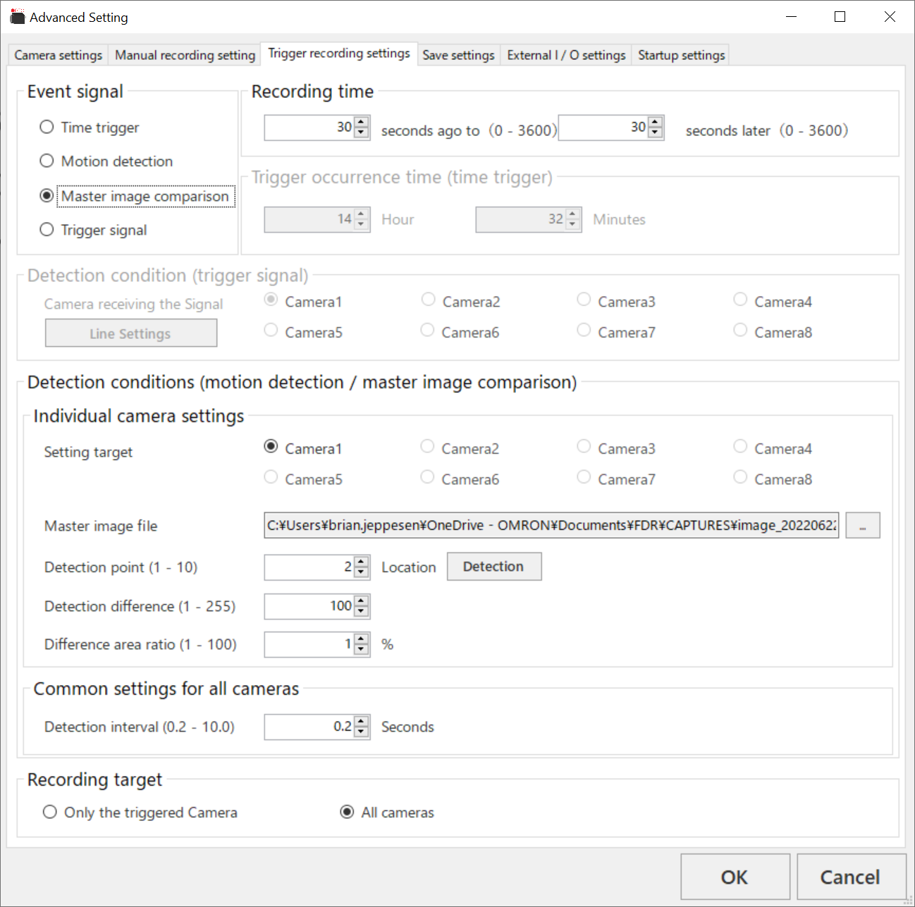
Setup for Master Image Comparison
Select settings/Trigger recording Settings
Select Event Signal to Master image comparison
Specify how long to record, before and after the Trigger.
Specify which camera to compare to the master image
Select the image to use as a master
Specify how many detection points to use
Click detection
  Set up the detection areas
  Check with event occurrence confirmation
Select detection interval
Select which cameras to record
Click “OK”
In main page set to trigger recording
Click on REC

Slide 17
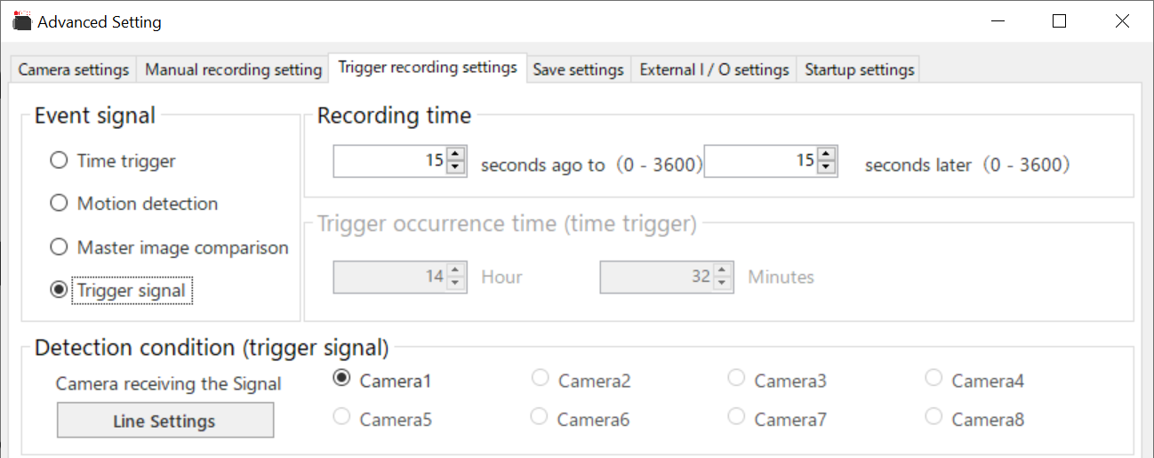
Setup for Trigger Signal
Select settings/Trigger recording Settings
Select Event Signal to Trigger signal
Specify how long to record, before and after the Trigger.
Click “OK”
In main page Change from manual recording to trigger recording

Slide 18
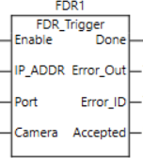
Trigger setup (Software)
Select settings/External I/O settings
In TCP input setting
  Change the IP address
    You cannot use the default address.
  Change the port number if desired
Click “OK”
Change the Ethernet port settings for TCP/IPv4
  Change IP address to match above
  Change subnet to
    255.255.255.0
On main page press REC
Send triggers in this format:
  trigger n(CR)
    N- camera number to record
      Use 0 for all
    (CR) is a carriage return
      ASCII decimal value 13
    Example
      trigger 2
      The above is followed by the carriage return
  A Sysmac function block is available

Slide 19
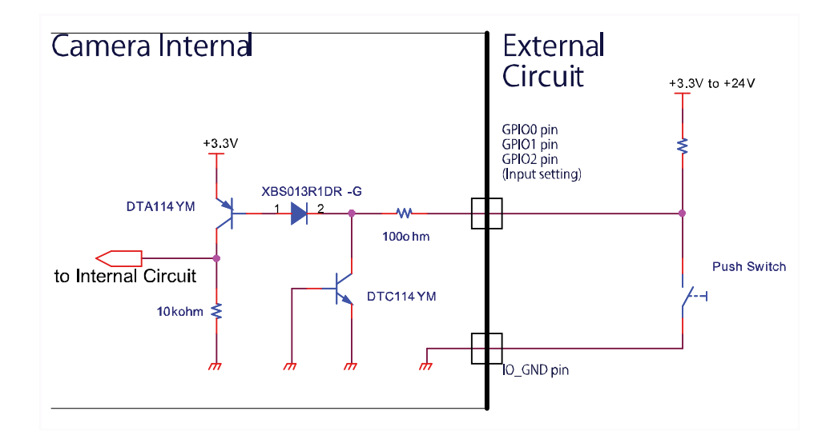
Trigger setup (Hardware)
Wire up the trigger connection to input 1 on the camera.
Refer to the camera’s manual for connection information.
  The i/o wiring of these cameras are different.
  Mis-wiring can cause camera damage
  You may need to install a series resistor
On main page press REC
Current limit (max) = 100ma

Slide 20
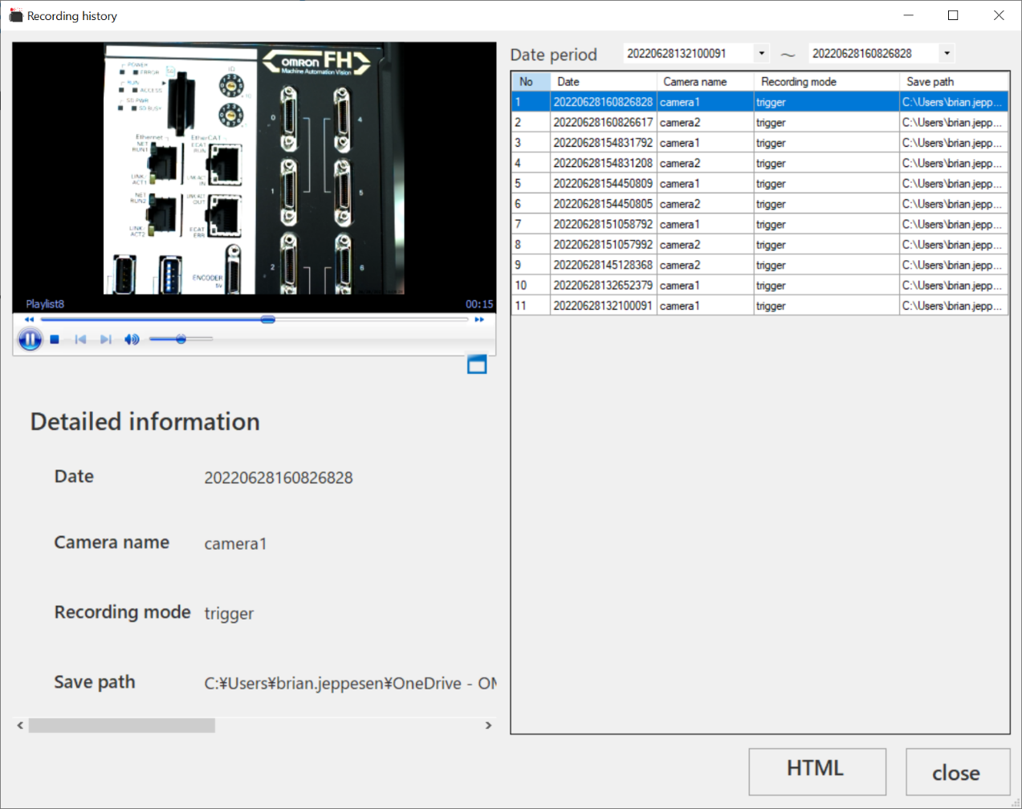
Viewing saved videos
In software:
  Click on history
  Select recording of interest
  Recording will play automatically
Third party software:
  Browse to file location and start third party software

Slide 21
Status over Ethernet
Status can be attained over Ethernet
  Recording start
  Type of trigger
  Camera number
    0 for all cameras
  Long file names for save files
A Sysmac Function block for this is available.

Slide 22
Remote monitoring
By taking remote control of the Factory Drive Recorder computer and running manual recording you can accomplish remote monitoring.

Slide 23
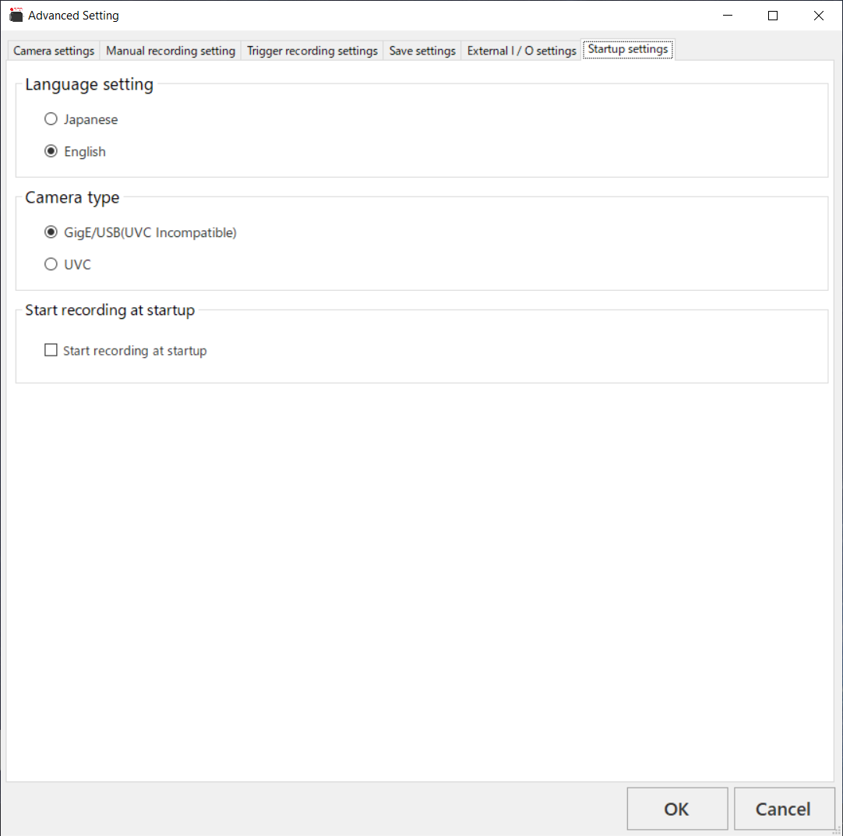
Start up settings
Select settings/Startup settings
  Specify language
    Japanese
    English
  Specify Camera type
    Non-UVC
    UVC
  Record at startup
    Upon startup software will be immediately ready for a trigger
      Based on your last setup

Slide 24
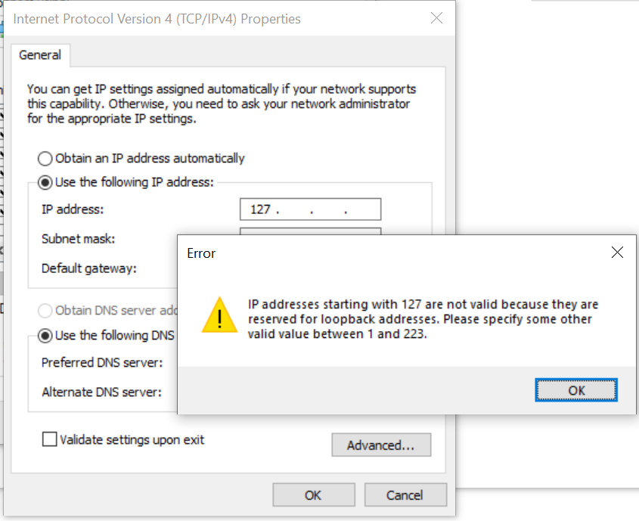
Considerations
Default IP Address
  The default IP address of 127.0.0.1 is not a valid IP address.
    This address must be changed if you intend to use Ethernet connections
A third party software is needed if you want slow motion playback

Slide 25
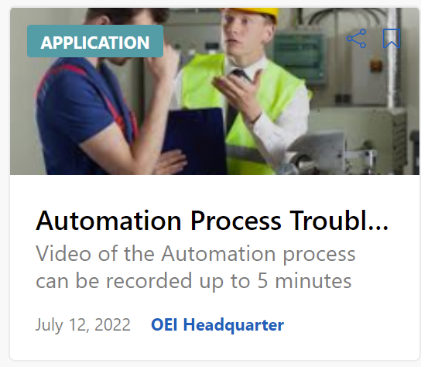
G-TKS
There is an application in G-TKS that has helpful information.
  Title: Automation Process Troubleshooting using the Factory Drive Recorder

Slide 26
Function Block Demo
Live demo of Sysmac function blocks.

Slide 27
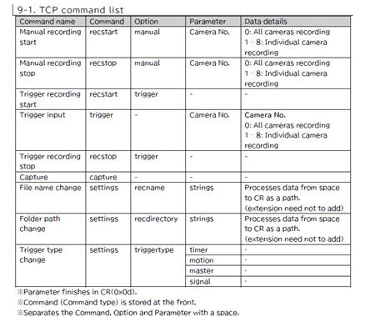
Last Minute Update
Ethernet/IP communications expansion

