Slide 1
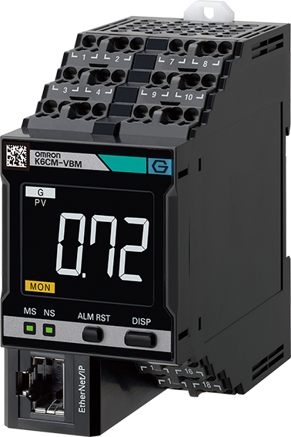
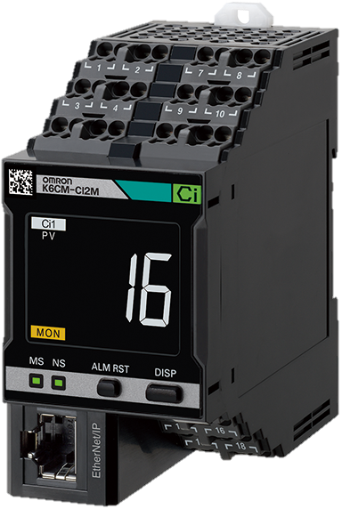
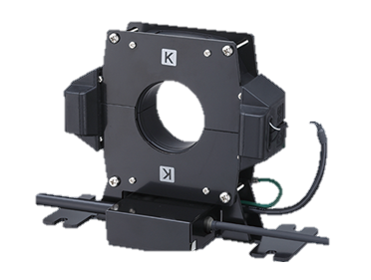
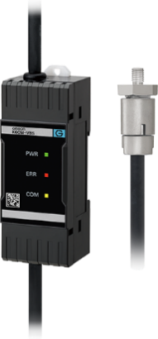
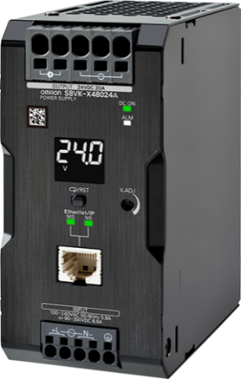
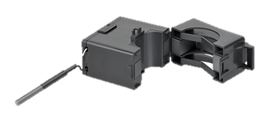
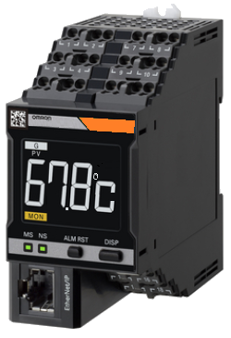
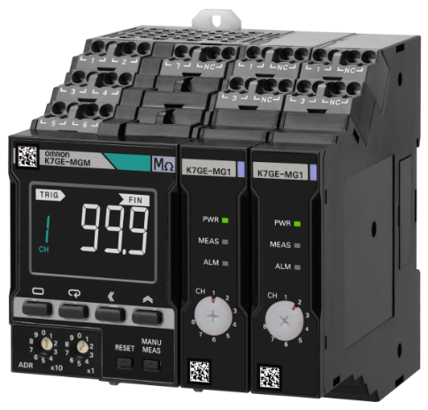
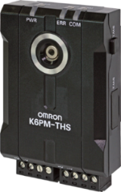
Predictive Maintenance
Remote condition monitoring to prevent unplanned downtime for critical equipment

Slide 2
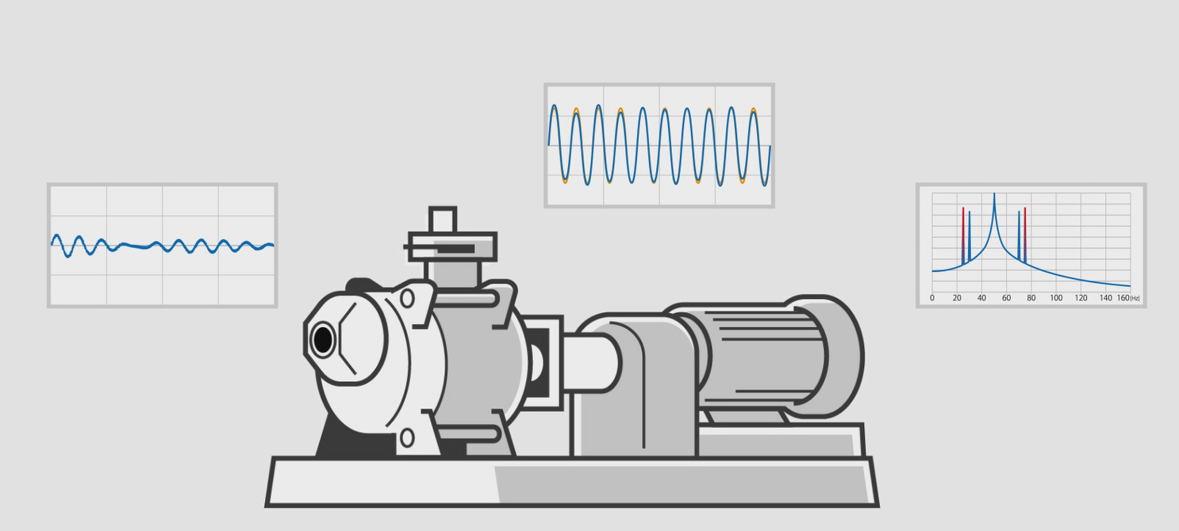
What is Predictive Maintenance?
Predictive maintenance (PdM) is a condition-based maintenance strategy that remotely monitors the condition of equipment using IoT sensor devices. The IoT sensors supply real-time data of equipment and analytics are performed to predict when the equipment requires maintenance.
From
To
Reactive Maintenance
(Run to failure)
Low maintenance costs
Higher probability of unplanned downtime
Cost of repairs can be much higher than the cost of preventive maintenance
Preventive Maintenance
(Time based)
Most common maintenance strategy
Scheduled maintenance
Labor intensive
Time consuming
Limited monitoring
Predictive Maintenance
(Condition based)
Continuous monitoring and analyzing of machine conditions
Predicts when equipment needs maintenance and perform maintenance accordingly
Reduces the need for frequent inspections
Lower maintenance costs $$ over preventive

Slide 3
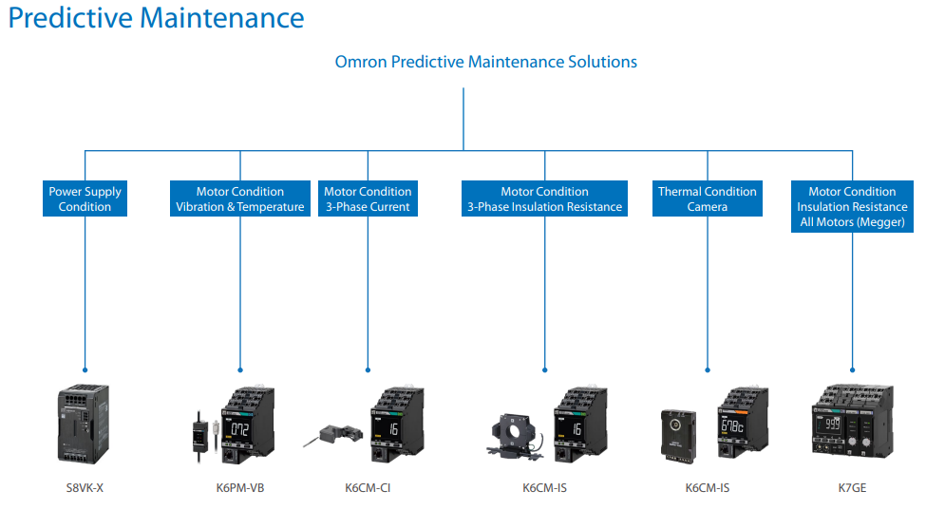
Click anywhere on this page to visit the component selection guide

Slide 4
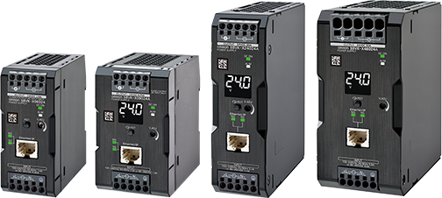
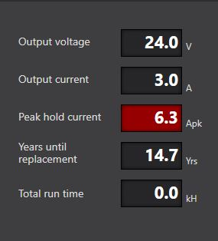
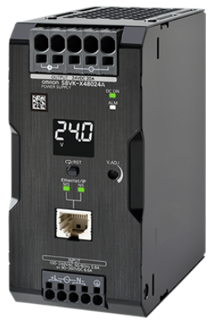
S8VK-X: Ethernet Connected Power Supply with condition status
Power supply supporting Ethernet/IP & Modbus TCP communication for remote monitoring
Monitors output voltage, current, peak current, run time, and life expectancy through onboard display or Ethernet connected free software
Customize alerts for low/high voltage & current conditions for up to 18 power supplies with the Omron monitoring software
Coated/sealed internal electronics for use in less than ideal environments
Available with and without display
Can interfaces with Omron’s Sysmac Studio
5 year warranty
Click on picture to link to datasheet
EIP version of our most popular power supply w live status

Slide 5
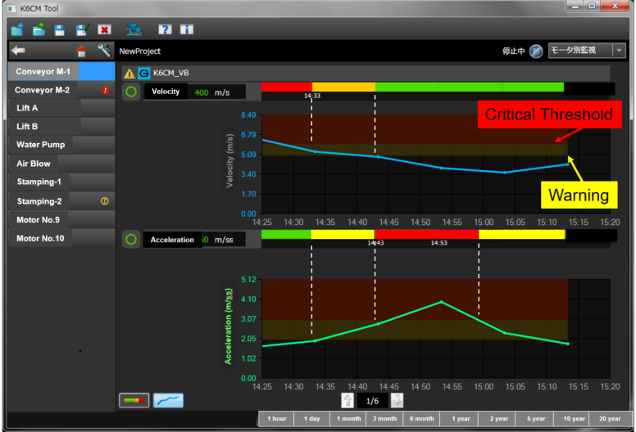
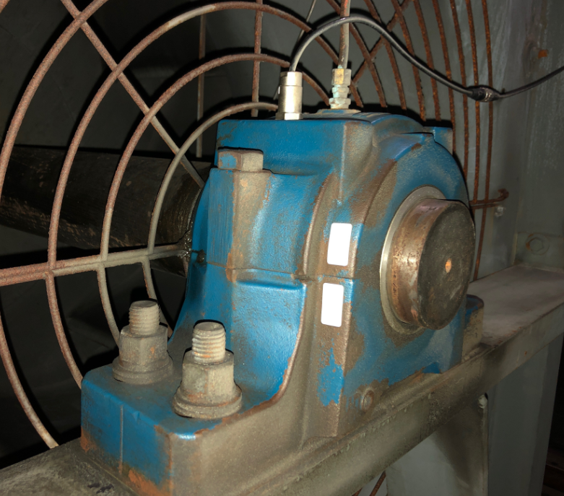
K6CM-VBM: Motor Temperature and Vibration Monitor with Ethernet communication
Vibration and temperature monitoring of 3 phase motors to detect bearing wear or excessive heat conditions
Measures velocity, acceleration, temperature, Δ temperature of a motor through a mounted sensor
Easy to retrofit: Sensor uses an M6 x 8mm thread which can install into motor casing. Optional magnetic mount is offered for additional mounting flexibility
Free software allows for threshold condition alarms in both temperature and vibration along with historical trend lines in condition
Monitor up to 10 motors/controllers with software
Interfaces with Omron’s Sysmac Studio
Rated for 3-phase constant speed induction motors
Click on picture to link to K6CM datasheet
Vibration and temperature monitoring of 3 phase motors

Slide 6
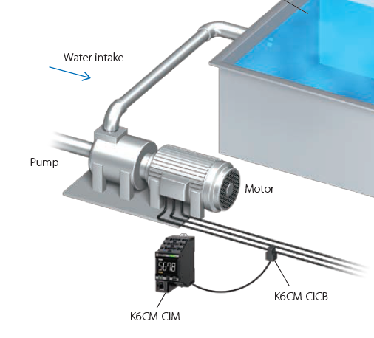
K6CM-CI: 3-Phase Motor Current Monitor with Ethernet communication
Monitor current draw sine wave abnormalities on 3 phase motors indicating debris, cavitation, misalignment, blockage or electrical
The “comprehensive current diagnosis” can monitor not only for motor problems, but also abnormal load-side conditions and notify the user
Simple retrofit of a current transformer clamp on the control panel enables monitoring
Software tool monitoring tool for all K6CM products also provided
K6CM-CI2M is suitable for use in an excessive noise environment such as using an inverter. Supports Modbus TCP and EtherNet/IP
Monitor up to 10 motors/controllers with software
Interfaces with Omron’s Sysmac Studio
Click on picture to link to K6CM datasheet
Current Monitoring for
3-phase motors for abnormality detection

Slide 7
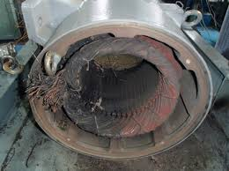
K6CM-ISM: 3-Phase Motor Insulation Resistance Monitor with Ethernet communication
Able to detect motor insulation breakdown on from heat and foreign debris
Easy to retrofit: Monitor 3-phase motors up to 300A 7.5 kw while motor is in operation using zero current transformer (ZCT) clamp
EthernetIP/Modbus communication remotely communicates live thermal feed along with alerts when using free software
Software allows for threshold condition alarms in insulation resistance with historical trend lines in condition
Monitor up to 10 motors/controllers with software
Interfaces with Omron Sysmac Studio
Click on picture to link to K6CM datasheet
Insulation resistance monitoring for operating/on condition 3-phase motors

Slide 8
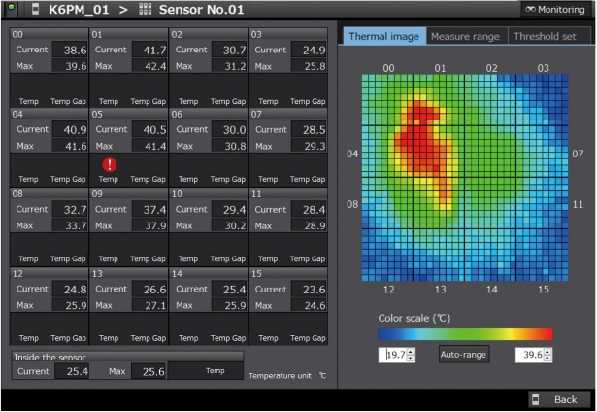
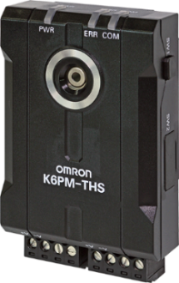
K6PM: Thermal Vision Condition Monitor with Remote Monitoring
Specifications:
Monitor temperature conditions of multiple devices with thermal camera sensors
Up to 31 cameras per controller
Predictive algorithms detect if current temperature trend will trigger alarms up to an hour before they happen
Connect controller to a PC and monitor live thermal conditions with included Thermal Condition Monitoring Software
User defined alarm thresholds when used with software
DIN-rail mount controller with built-in temperature display and alarms
Reduce setup and analysis time with built-in temperature algorithms
Interfaces with Omron’s Sysmac Studio
Click on picture to link to K6PM datasheet
EIP Thermal imaging camera system with

Slide 9
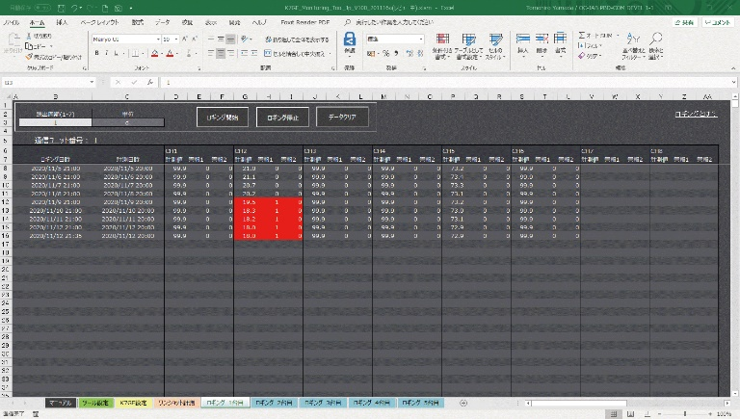
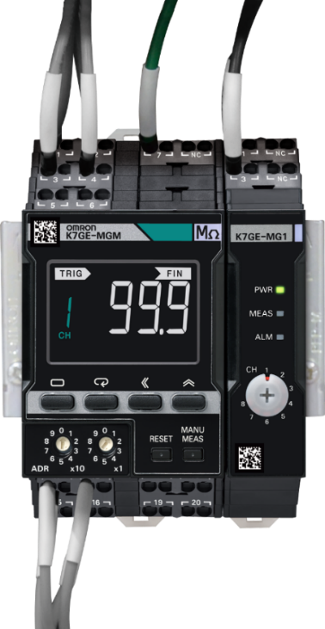
K7GE: Servo Motor Insulation Resistance Monitor
Monitor insulation of 1, 3-phase or servo motors; monitor any motor any size through the megger method
Programmable automatic insulation resistance testing using 50V Megger/IR test when a trigger signal is input
Identifies trend in insulation deterioration from the measurement data collected via monitoring probes
Clear multi-function LCD display w alarm bar
RS-485 Modbus RTU serial connection for remote monitoring
Up to 8 modular probes per controller
Free PC monitoring software supporting up to 5 sets of monitoring devices (8 probes=1 set) triggering alarm at programmable value.
0.1- 99 M Ω measurement range
Interfaces with Omron’s Sysmac Studio
Click on picture to link to datasheet
Automated resistance monitoring of equipment

Slide 10
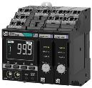
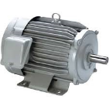
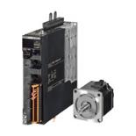
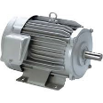
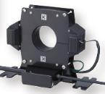
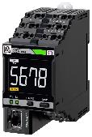
Difference Between K7GE and K6CM-ISM
Interface
Sensor
Target Application
Measurement range
& condition
Number of motor
K7GE
No sensor
(But need to connect some wiring between K7GE and motor)
Any motor any size
> Servo motor
> 1&3 phase induction motor
Insulation resistance
0.1 M to 99.9 M
One unit for up to 8 motors
RS-485
+
・・・
Measure during motor power off
(RTU)
K6CM-ISM[]
ZCT
(Clamp type)
3 phase induction motor up 7.5kW
Insulation resistance
0.000 M to 1.000 M
＆
Leakage current
0.0 mA to 200.0 mA
One unit for one motor
3 phase 3 wires S-grounding
(TCP)
Measure during motor running
3 phase 4 wires N-grounding
Notes:
This is a nice comparison to show the difference between the two insulation resistance products to highlight the difference. The K7GE has more labor on the install, but more capabilities overall, allowing for monitoring of up to 8 motors of any size/configuration, but would typically be used with a PLC or other device that accepts a RS-485 Interface.

Slide 11
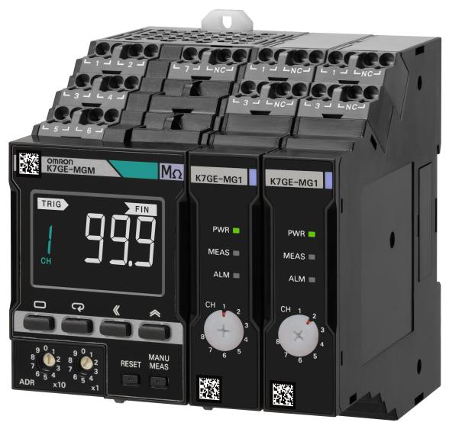
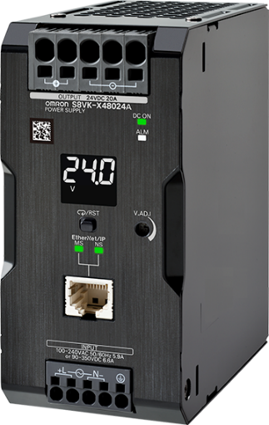
Complete Line of options for your Predictive Maintenance needs
Notes:
Hello, welcome to the predictive maintenance solutions webinar. My name is Justin Lantin and I’m the product manager for Omron Components.
Today, I’m excited to talk you all about some Omron predictive maintenance solutions that can help transform your plant’s maintenance strategy. These solutions will help reduce unplanned downtime on your equipment and minimize maintenance costs through remote condition monitoring.

