Slide 1
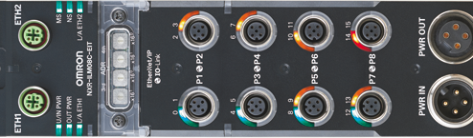
NXR
Rugged IO-Link Master and Hubs

Slide 2
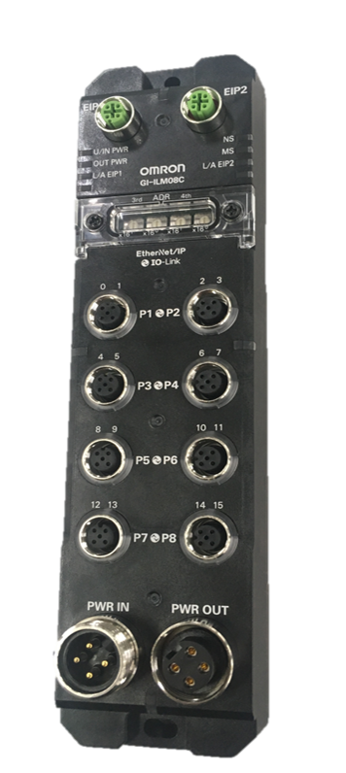
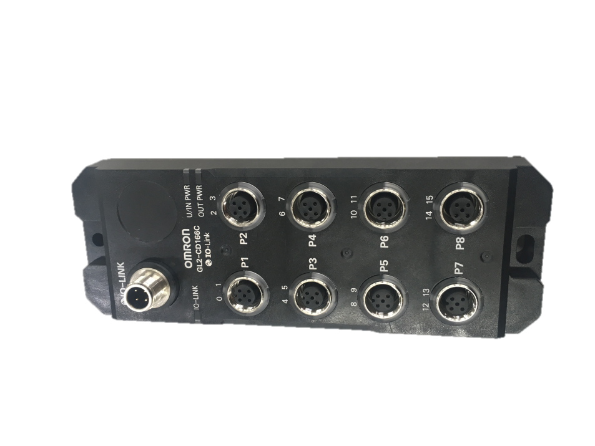
NXR Product Overview
IP 67
EtherNet/IP
IO Link
  Master NXR-ILM08C-EIT
    Configurable input/outputs
  Hub
    Input Only NXR-ID166C-IL2
    Configurable NXR-CD166C-IL2

Slide 3
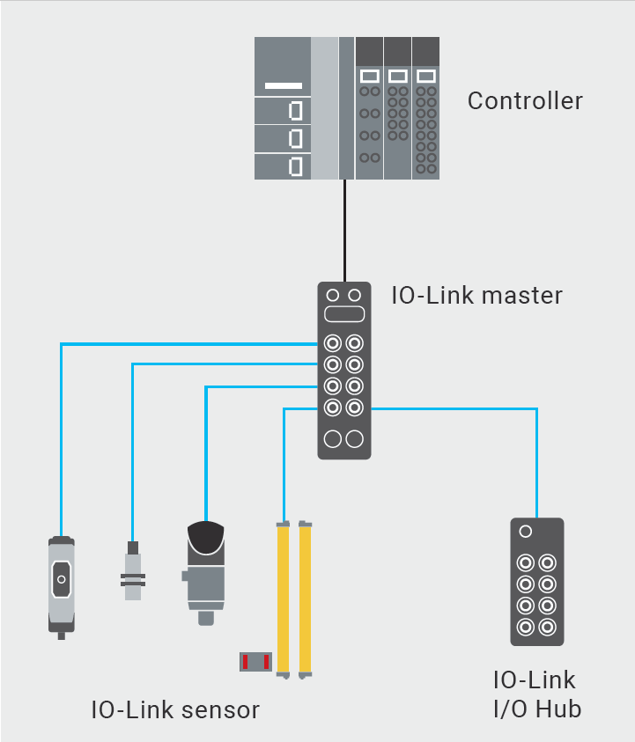
NXR Distributed I/O Platform with IO-Link
NXR is a new I/O platform for Sysmac that provides Rugged on machine solutions for I/O
Benefits:
  Diagnostic information from IO-Link devices.
  NXR masters and hubs leverage cables with quick connectors to simplify wiring and save time in commissioning.
  IO-Link and Sysmac Integration provide enhanced information to and from devices while minimizing costs, IP address utilization, and network bandwidth.

Slide 4
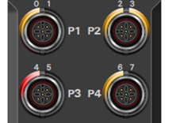
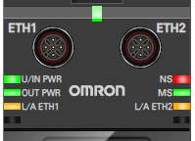
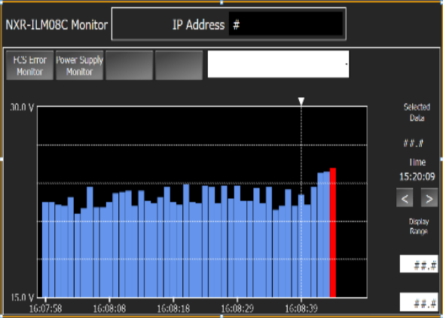
Benefit: Diagnostic Information
Short Circuit Detection
Wire break location detection
Open Wire detection
LED indicators for quick status identification
Input/Output Voltage Monitoring
Network quality monitoring
NXR’s enhanced diagnostic information makes it easy for maintenance personnel to quickly identify the cause of a fault to minimize the length of downtime incidents.

Slide 5
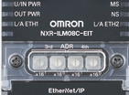





Benefit: Reduced Commissioning
IP67 and quick connectors make it easy to connect to devices where they are mounted and reduces long wire runs.
Rotary switches simplify IP address setting
IO-Link hubs combine with masters to reduce wiring and save IP address usage.
The NXR makes it easy for OEM’s to set up new systems quickly and End Users to replace devices efficiently.

Slide 6
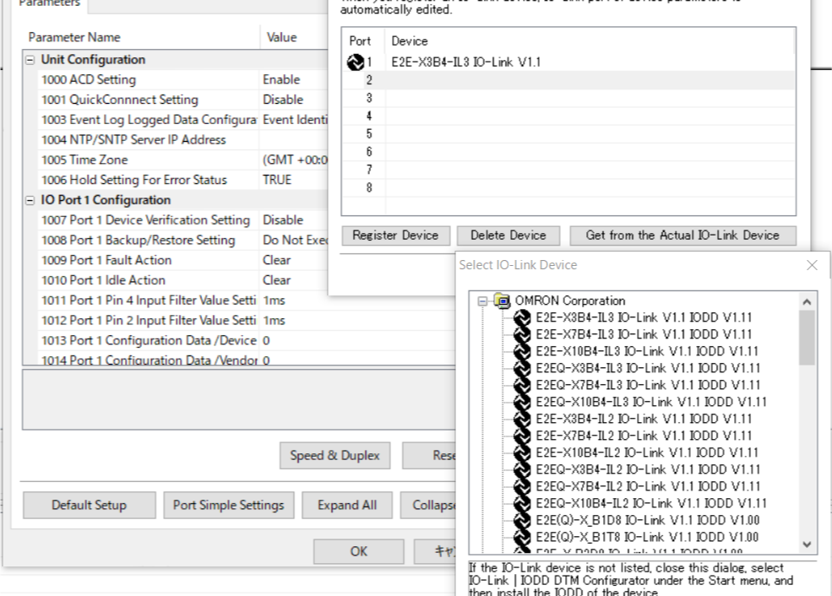
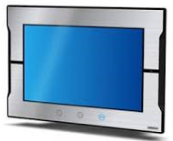
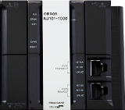

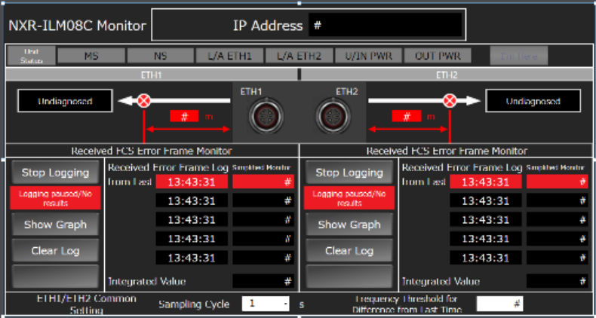
Benefit: IO-Link and Sysmac Integration
Easy to configure in Sysmac Studio
Pre built IAGs for HMI notifications
Omron provides a full IO-Link Solution from Sensor to IO to PLC to HMI
Store parameters as part of project for ease of repeatability and implementation
Enhanced data collected from IO-Link devices combined with data sharing capabilities of Sysmac adds to IIoT initiatives
The NXR integrates IO-Link functionality with superior integration in Sysmac to reduce commissioning time, improve diagnostics, and enhance visibility into plant operations.

Slide 7
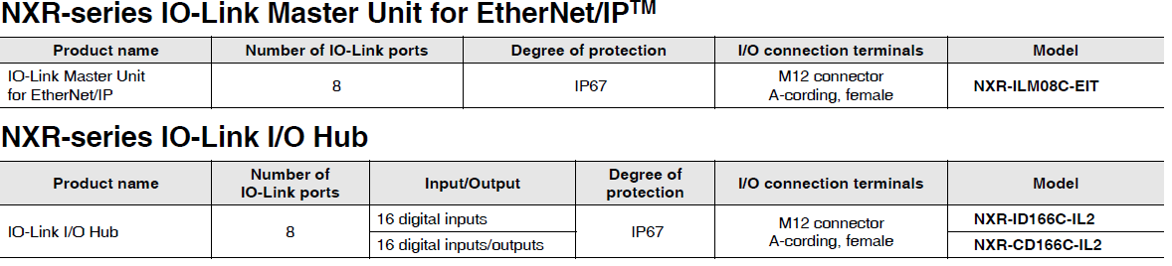
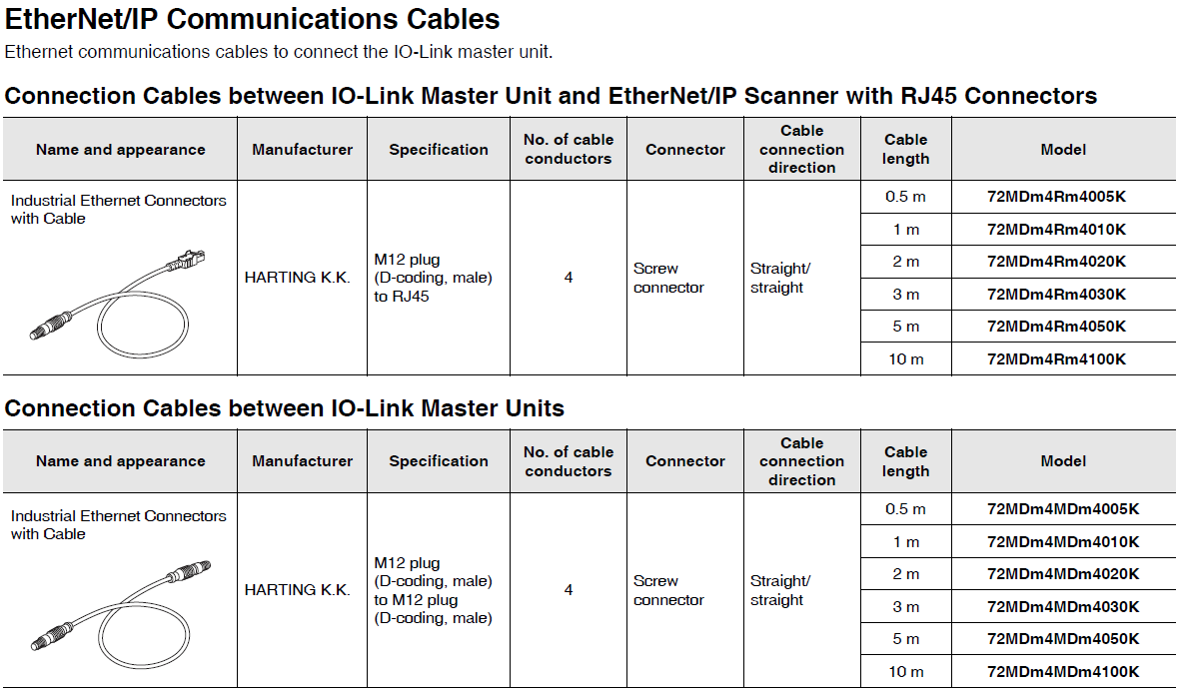
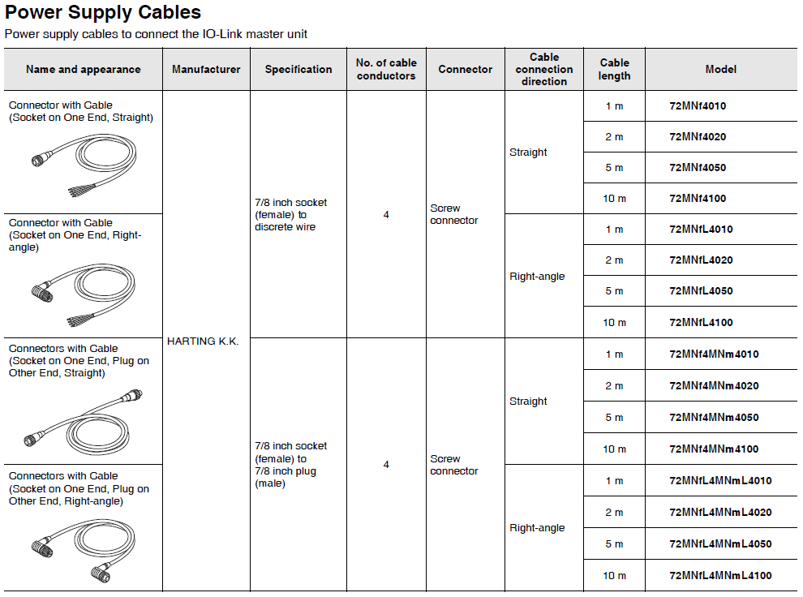
Ordering Information
EtherNet/IP and Power Cables should be purchased from Harting and are not available from Omron.

Slide 8
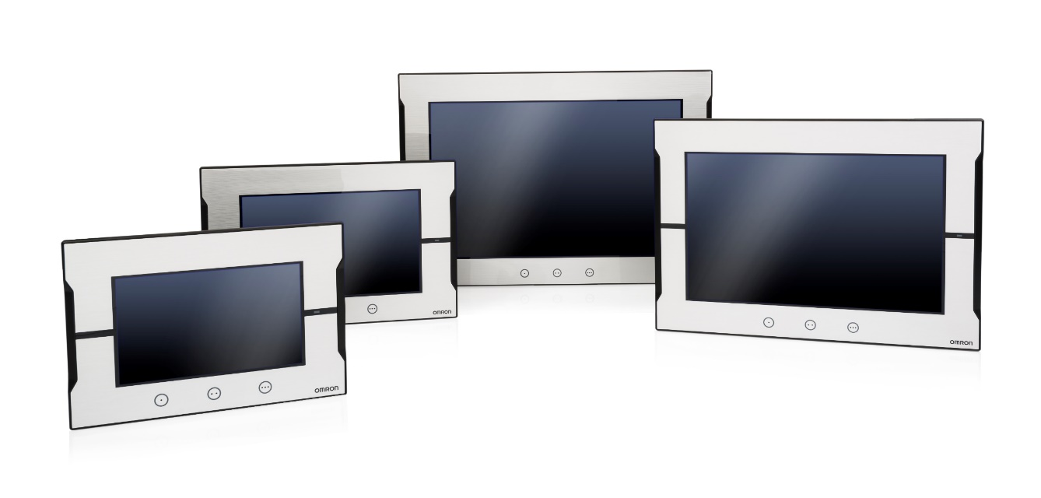
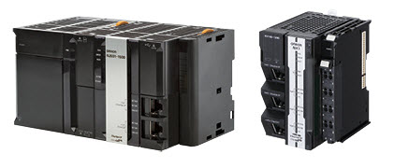
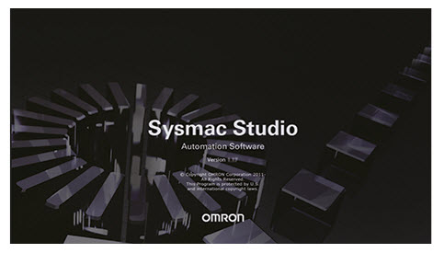
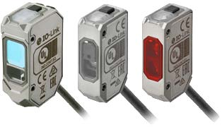
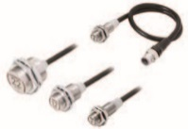


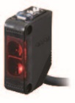
Related Products
Sysmac Controllers
NA HMI
(Pre-Built IAGs Available)
IO-Link Sensors
E3AS E2EW E3D-DC E8PC E3Z-□-IL□
Sysmac Studio

Slide 9

Collateral
Description | Media | Publication Number
NXR Master User Manual | PDF | W619-E1-03
NXR Master Datasheet | PDF | CSM_NXR-ILM08C-EIT_DS_E_2_1
NXR Hub Datasheet | PDF | CSM_NXR-_D166C-IL2_DS_E_2_1
Product Guide | PDF | R50I-E-01
Brochure | PDF | R202I-E3-02

Slide 10
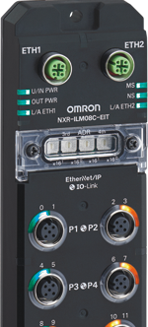
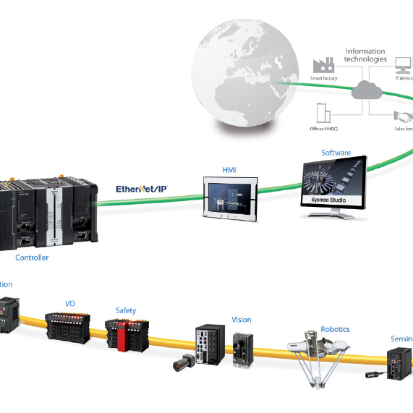


Key Takeaways
Full IO-Link Solution for Sysmac Users
Reduce Commissioning & Troubleshooting
IIoT Solution with increased data availability

